Slide 1
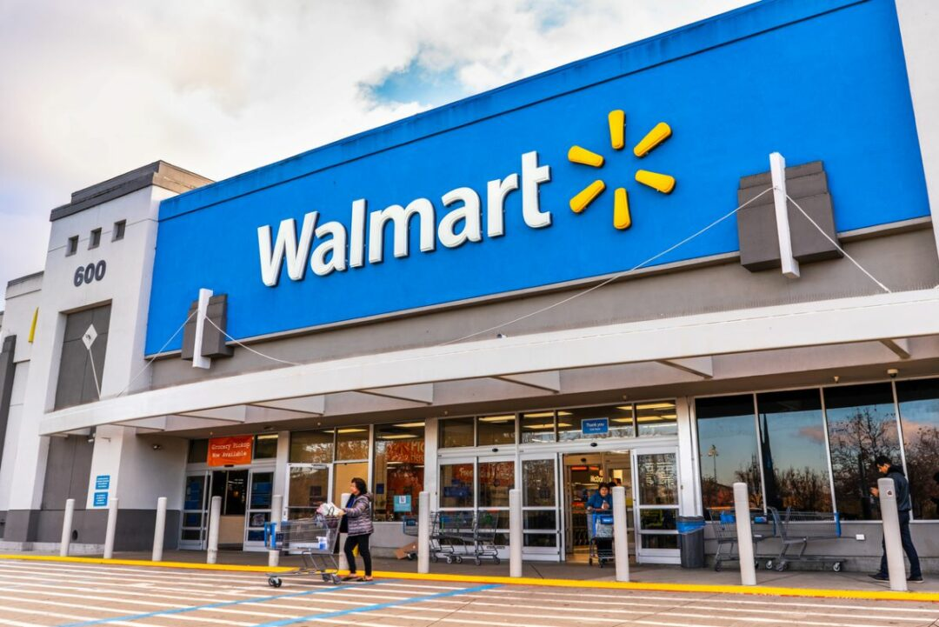
Inventory Management and Sales Forecasting of Walmart Stores
Shriya Singh
24f2008693@ds.study.iitm.ac.in

Slide 2


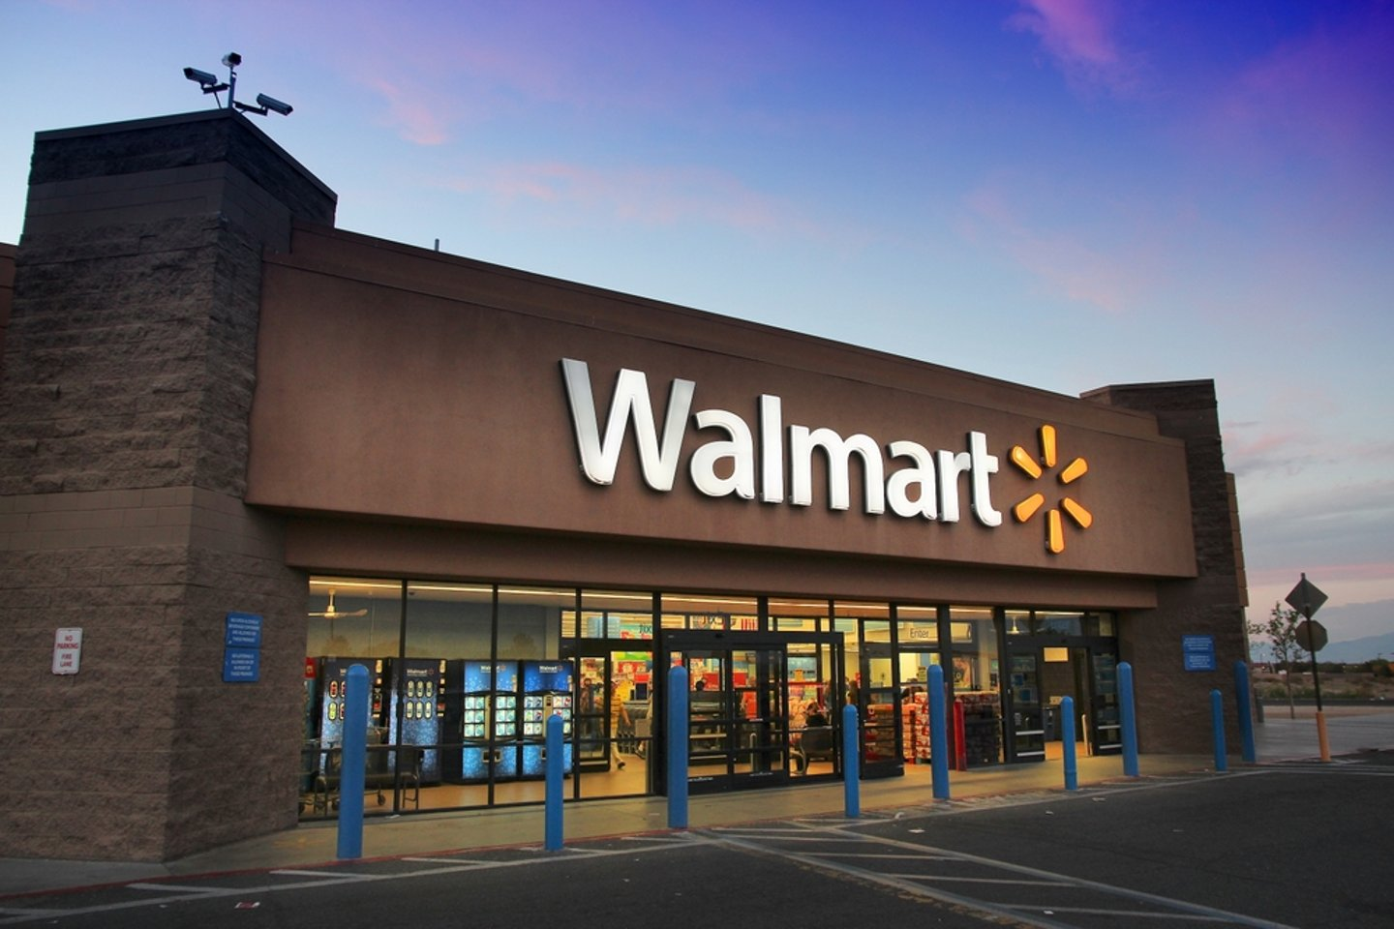


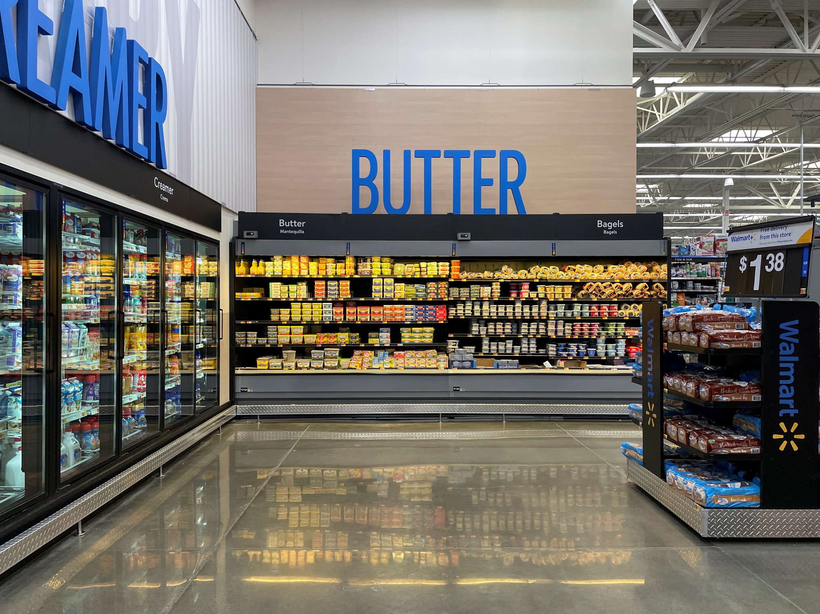
ABOUT THE BUSINESS
Walmart Inc is an American multinational Retail Company that operates a chain of hypermarket, departmental store and grocery stores in the US and 23 other countries.
It is headquartered in Bentonville, Arkansas. The company was founded in 1962 by brothers Sam and James Bud Walton.
The business primarily operates in B2C providing vegetables and daily household items to customers seeking to buy daily goods. Walmart acquired app uses AI to let customers try on clothing via a dynamic virtual platform.

Slide 3
The Problem Statement
To forecast the sales of each store for the next 12 weeks to reduce overstocking and understocking problems.
Optimizing inventory management by aligning supply with demand through customer purchasing insights.

Slide 4
Data Overview
The following data was collected from the duration of February 2010- October 2012
Walmart Stores Data
Walmart Product Data
Store
Date
Weekly Sales
Holiday Flag
Temperature
Fuel Price
CPI
Unemployment
Gender
Product Line
Unit Price
Quantity
TAX
Payment
COGS
Gross Margin

Slide 5
Analysis
Process
Exploratory Data Analysis
Statistical Data Analysis
Model Building
Predictive Analysis
01
02
03
04

Slide 6
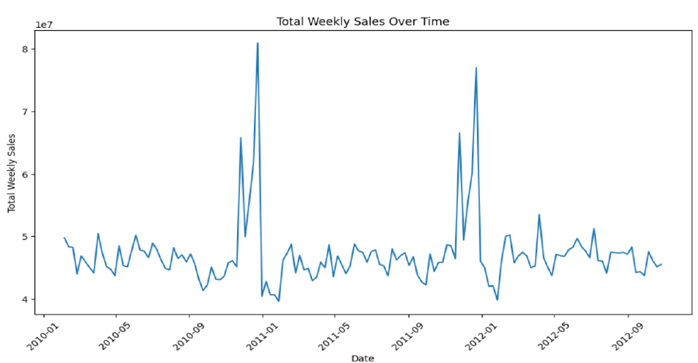
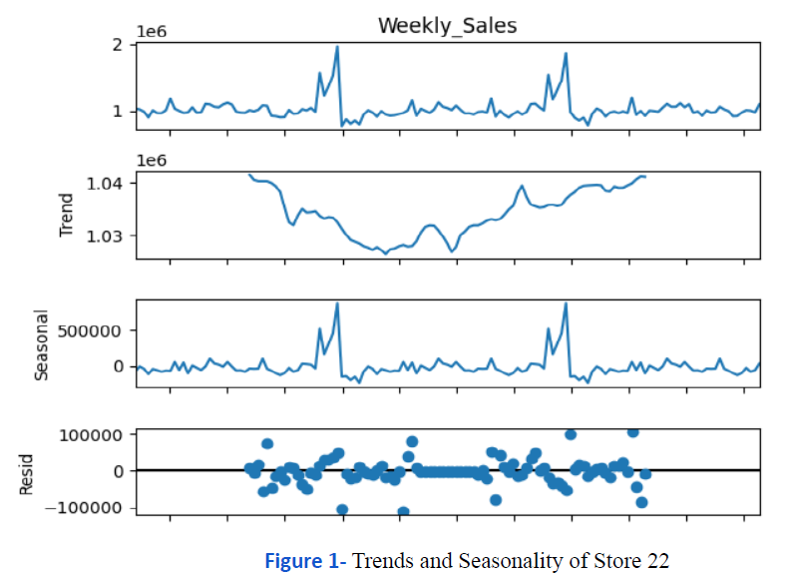
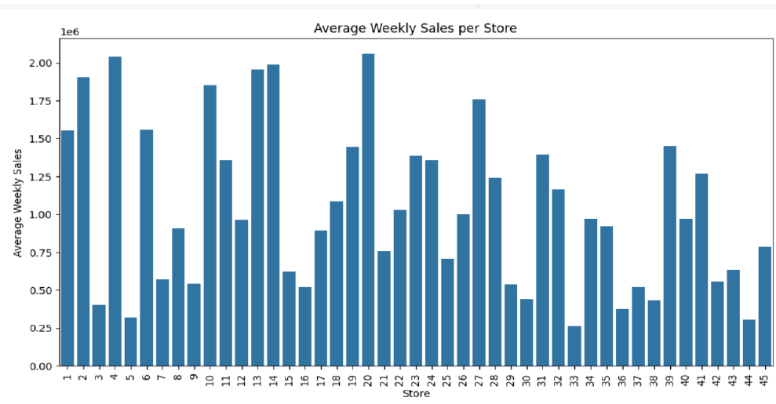
INSIGHTS OVERVIEW
Our Category
XX%

Slide 7
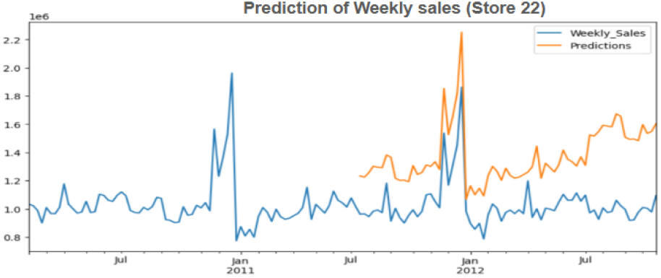
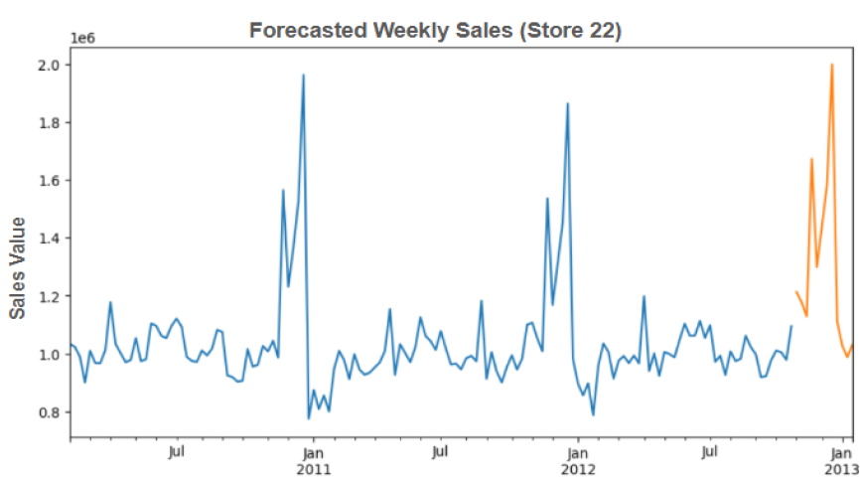
PREDICTIVE ANALYSIS
Historical Trends Remain Consistent. The predicted values for early 2013 show an unexpected surge. The increase is abrupt, which is based on historical patterns.
Both actual and predicted sales show sharp spikes at certain points, especially in early 2011 and late 2012. It could be due to seasonal sales, external factors.
Our Category
XX%

Slide 8
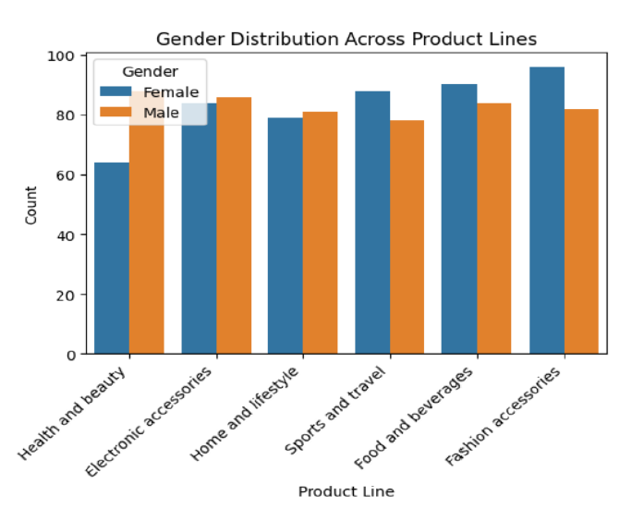
RESULTS
The lowest performing store is store number 38 with the lowest sales value among all the stores, whereas Store number 20 makes the highest sales and revenue generation.
Electronic accessories is the most bought product category by the customers, followed by food and beverage items. Food and Beverages has the highest total sales. Fashion Accessories has the highest total unit price
Sales tend to increase gradually from July 2011 to October 2012. The highest predicted sales appear in October 2012.
The data shows significant spikes around year-end, the actual sales show seasonal spikes at regular intervals.
35%
50%
5%

Slide 9
RECOMMENDATIONS
Focus promotions based on gender preference, such as more beauty-related deals for male customers while Food and Beverage for females. Keeping enough stocks of those products to meet the demands of customers.
Stock more of the high-selling products like Electronic and Food & Beverages. Fashion accessories should have a good amount of stock, it’s the highest demand by customers.
Analyze why some categories have a gender imbalance and adjust pricing or promotions accordingly, like Health-beauty products, Sports & Lifestyle
Run targeted promotions significantly of products which are preferred by customers leading up to peak sales months. Optimize supply chain and continuously monitor key sales drivers and identify the peak sales months to manage the required stock on time.

Slide 10
BDM PROJECT
https://drive.google.com/drive/folders/1ZQH_U2Wj5rjLtN4NiGRHDe5OidKcR8jW?usp=sharing

